Slide 1
Who was to blame for the Second World War?

Slide 2
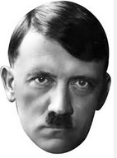
Hitler’s actions
PLANNED?
GAMBLE?

Slide 3
Be able to explain each event and why they made war more likely
1.Rearmament, secret from 1933, open by 1935
2.The Saar Plebiscite, 1935
3.Remilitarisation of the Rhineland March 1936
4.The Spanish Civil War, 1936
5.Axis Alliance, 1937
6.Anschluss with Austria, 1938
7.The Sudetenland, 1938
8.Czechoslovakia, 1939
9.The Nazi Soviet Pact, 1939
10. Hitler invades Poland, 1 Sept 1939

Slide 4
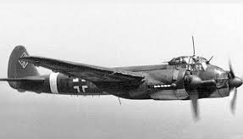
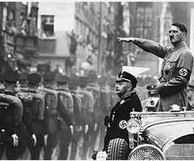
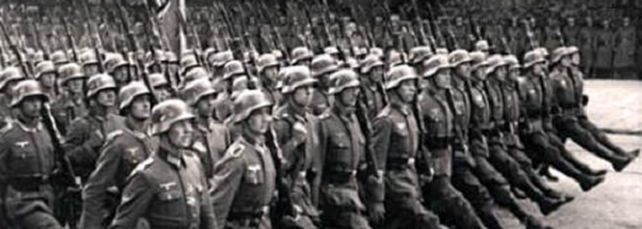
1. Rearmament, secret from 1933, open by 1935
Almost as soon as Hitler became Chancellor of Germany he began secretly building up Germany's army and weapons. In 1934 he increased the size of the army, began building warships and created a German air force.
Conscription was introduced in 1936.
By March 1935, Hitler felt strong enough to go public about Germany’s rearmament.
Europe learned that the Nazis had 2,500 war planes in its Luftwaffe and an army of 300,000 men in its Wehrmacht.

Slide 5
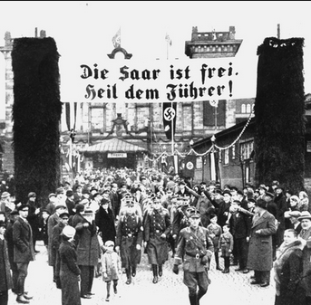
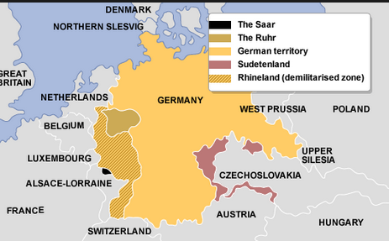
2. The Saar Plebiscite 1935
The Treaty of Versailles had put the Saar under the control of the League of Nations for 15 years.
In 1935 the people who lived in the Saar had a vote (plebiscite) to decide if they should become part of Germany again.
Both sides campaigned hard!
17,000 Nazi Saarlanders threatened to invade the Saar and impose Nazi rule . They changed their minds in December 1935 when Britain offered to send soldiers to keep the peace.
On 13 January 1935, the plebiscite was held. Foreign observers declared that the election had been fair.
90.3% of the voters voted to return to Germany.

Slide 6
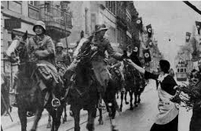
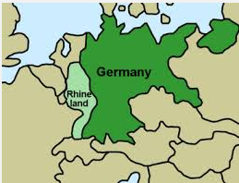
3. Remilitarisation of the Rhineland March 1936
In 1936 Hitler ordered German troops to enter the Rhineland.
At this point the German army was not very strong and could have been easily defeated.
Hitler later said the march into the Rhineland had been the most nerve-racking 48 hours of his life.
"If France had then marched into the Rhineland, we would have had to withdraw with our tails between our legs." - Hitler

Slide 7
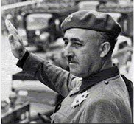
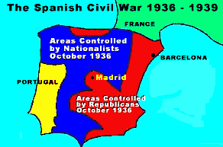
4. The Spanish Civil War 1936
In 1936, The Spanish Civil War began
between the right-wing Nationalists and the army Vs the left-wing Republicans.
The dictator General Franco led the Nationalists.
Hitler and Mussolini both sent thousands of troops and weapons to Spain to aid the Nationalist forces. They both had similar aims to the dictator Franco.
As fascists, Hitler and Mussolini did not want the left-wing Republicans to win. Hitler wanted a right-wing ally: Franco
Hitler knew helping Franco would give him the opportunity to test out his new commanders, weapons and tactics.

Slide 8
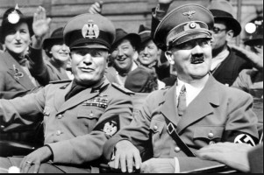
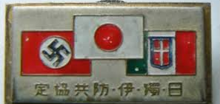
5. Axis Alliance 1937
Hitler made two important alliances during 1936. The first was called the Rome-Berlin Axis Pact and allied Hitler's Germany with Mussolini's Italy.
The second was called the Anti-Comintern Pact and allied Germany with Japan.
Italy also signed the Anti-Cominterm Pact in 1937.
Hitler was now in an alliance with two other dictatorships.

Slide 9
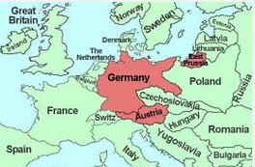
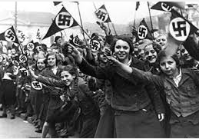
6. Anschluss with Austria 1938
In 1938, Hitler took over Austria.
First, Hitler encouraged the Austrian Nazis to demand union with Germany.
Then in March 1938, German troops marched into Austria.
The Austrian leader was forced to hold a vote asking the people whether they wanted to be part of Germany.
The results of the vote were fixed and showed that 99% of Austrian people wanted Anschluss (union with Germany).
The Austrian leader asked Britain, France and Italy for aid.
Hitler promised that Anschluss was the end of his expansionist aims.

Slide 10
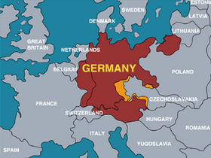
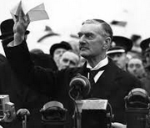
7. The Sudetenland, 1938
Hitler demanded that the Sudetenland region of Czechoslovakia be handed over to Germany.
Neville Chamberlain, Prime Minister of Britain, met with Hitler three times during September 1938 to try to reach an agreement that would prevent war.
The Munich Agreement was signed.
The Munich Agreement stated that Hitler could have the Sudetenland region of Czechoslovakia provided that he promised not to invade the rest of Czechoslovakia.

Slide 11
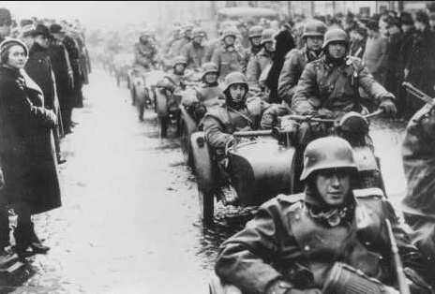
8. Czechoslovakia, 1939
In March 1939, Hitler invaded the rest of Czechoslovakia.
Despite calls for help from the Czechoslovak government, neither Britain nor France was prepared to take military action against Hitler.

Slide 12
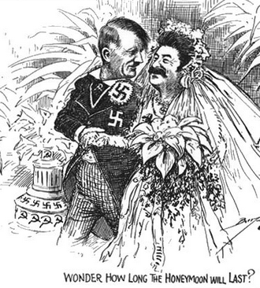
9. The Nazi Soviet Pact, 1939
In April 1939, Stalin suggested an alliance of Russia, France and Britain against Germany.
Hitler would not have been able to invade Poland if it meant war with Russia.
They didn’t manage to agree an alliance because
  Britain did not like communist Russia.
  Stalin did not trust that France and Britain would resist Germany.
Out of the blue, on 23 August 1939, Hitler made the Nazi-Soviet Pact with Stalin. This was a promise not to go to war with each other and (secretly) a promise to invade Poland and split it between them.

Slide 13
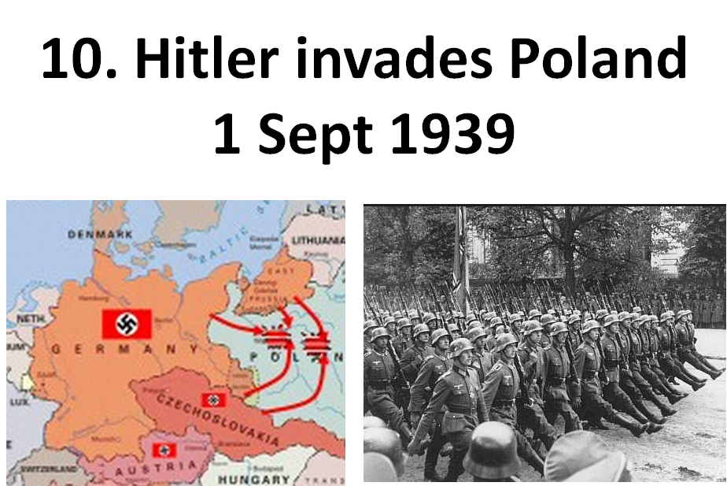
Hitler did this for many reasons but the most important were:
To give Germans lebensraum in Eastern Europe. He had promised this in Mein Kampf (1924) and it was one of the three CENTRAL AIMS of Hitler foreign policy.
Because he thought Chamberlain would not dare stop him. Appeasement had encouraged him.
This was what he had agreed with Stalin in the Nazi Soviet Pact.

Slide 14

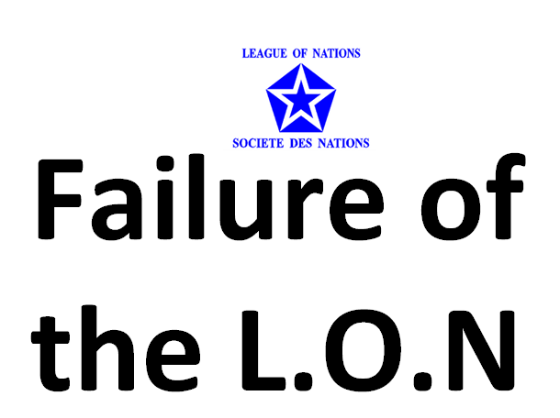
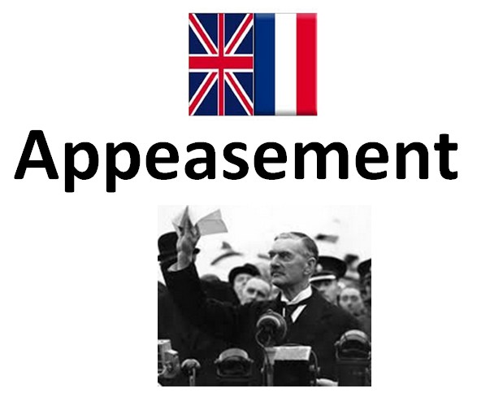
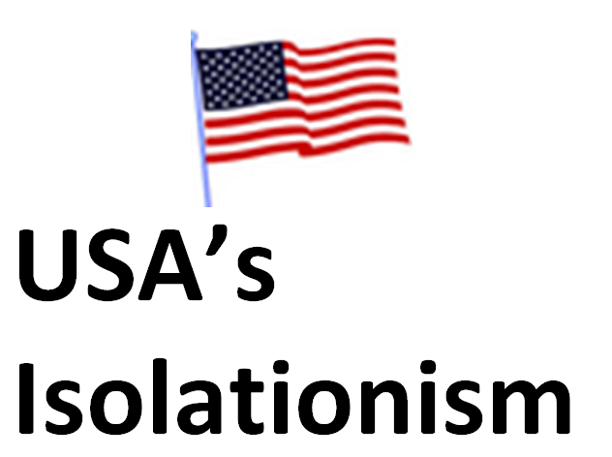
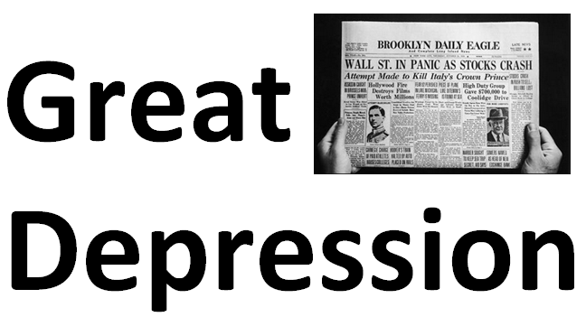
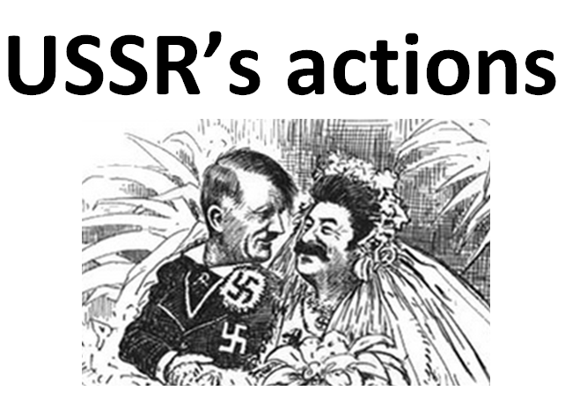
If the treaty had not been so harsh could things have been different? Hitler got a lot of support from promising to tear it up!
If the League had been stronger could they have stood up to Hitler and the other aggressive dictatorships (Italy, Japan, even the USSR)? Were they too self interested and toothless?
No matter how good (or not) the intentions behind it – were Britain and France wrong to let Hitler get away with so much. What if they had tried to stop him sooner?
If the USA had taken more responsibility and not been determined to stay out of foreign entanglements, would Hitler have been less aggressive?
If Germany and the world have not become so desperate, would people like Hitler have found so much support?
Was Stalin aggressive and greedy? Did he underestimate Hitler?

Slide 15
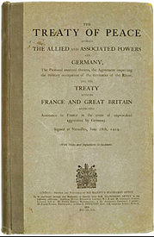
Treaty of Versailles

Slide 16

Failure of the L.O.N

Slide 17
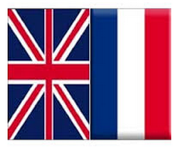
Appeasement

Slide 18

USA’s
Isolationism

Slide 19
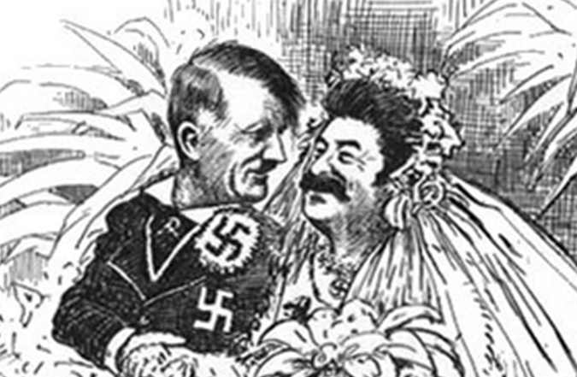
USSR’s actions

Slide 20
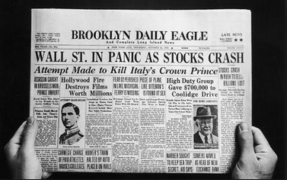
Great Depression

